Slide 1
Lab 19

Slide 2
Goal
Work with GUI’s again and get familiar with Menu bars, menus and action listeners

Slide 3
Prep
Import SampleGUI, SampleGUIMain and File MenuHandler

Slide 4
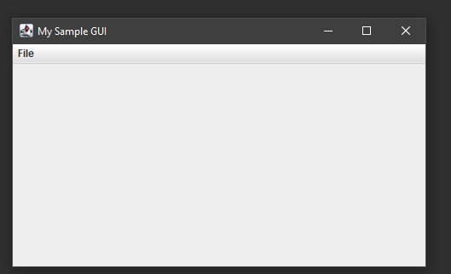
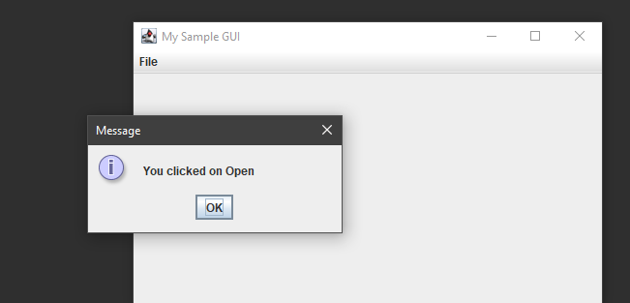
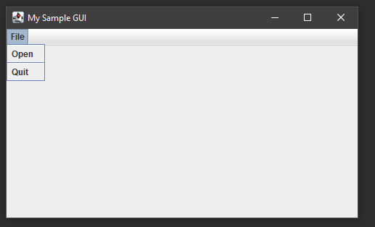
Run code
Run SampleMain, you should get the out below

Slide 5
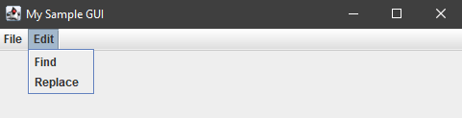
Add a new menu to SampleGui
You will want to create a new JMenu named editMenu and titled Edit
You will also want to add two items to this menu Find and Replace.
You will be reusing syntax already in the code, specifically the code to create a new JMenu (17), a new JMenuItem (20, 26), add that item to the Menu (22, 28) and to add the Menu to the menuBar (31)
If done correctly your output should look like what we have below and the Find and Replace will not do anything when clicked on yet

Slide 6
Create EditMenuHandler
You can easily create EditMenuHandler by copying FileMenuHandler and pasting it into the src folder for this project, it should give you the option to rename the class, just rename it to EditMenuHandler
Once you have it you need to update the actionPerformed method to check for Find and Replace instead of Open and Quit.
Don’t forget to update the message dialogs as well

Slide 7
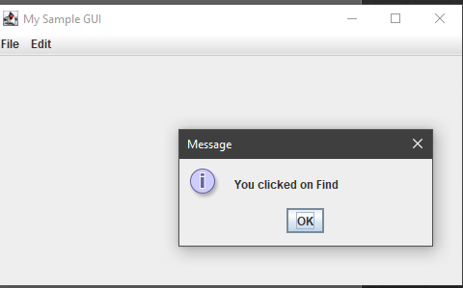
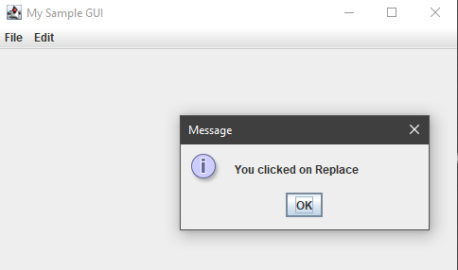
Implement EditMenuHandler
You now need to create an EditMenuHandler object similar to how the FileMenuHandler object was created in line 18
Then similarly to line 21 and 27 before you add the items for Find and Replace to the editMenu you should add an action listener to them passing the EditMenuHandler object
If done correctly you should get the correct message for each item popup when clicked

